Slide 1
"Building and Deploying an Email Spam(PHISHING)Detector"
Project Overview and Chrome Extension Demonstration

Slide 2
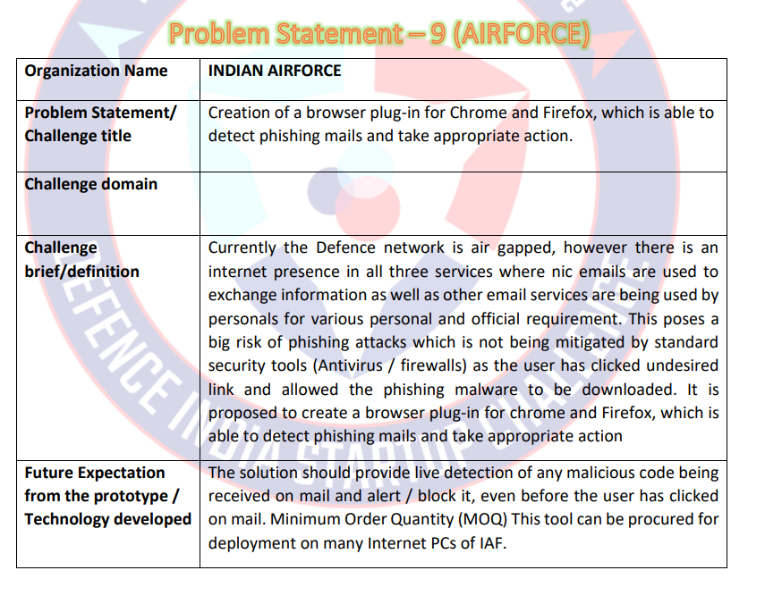
PROBLEM: 2
GIVEN FROM INDIAN AIR FORCE
SUBJECT FROM A.I.
REQUIREMENTS:
PLUGIN DEVELOPMENT

Slide 3
Project Overview
"Leveraging machine learning to detect email spam, from data collection and model training to deployment as a Chrome extension”
Data processing
Model training
Chrome extension.

Slide 4
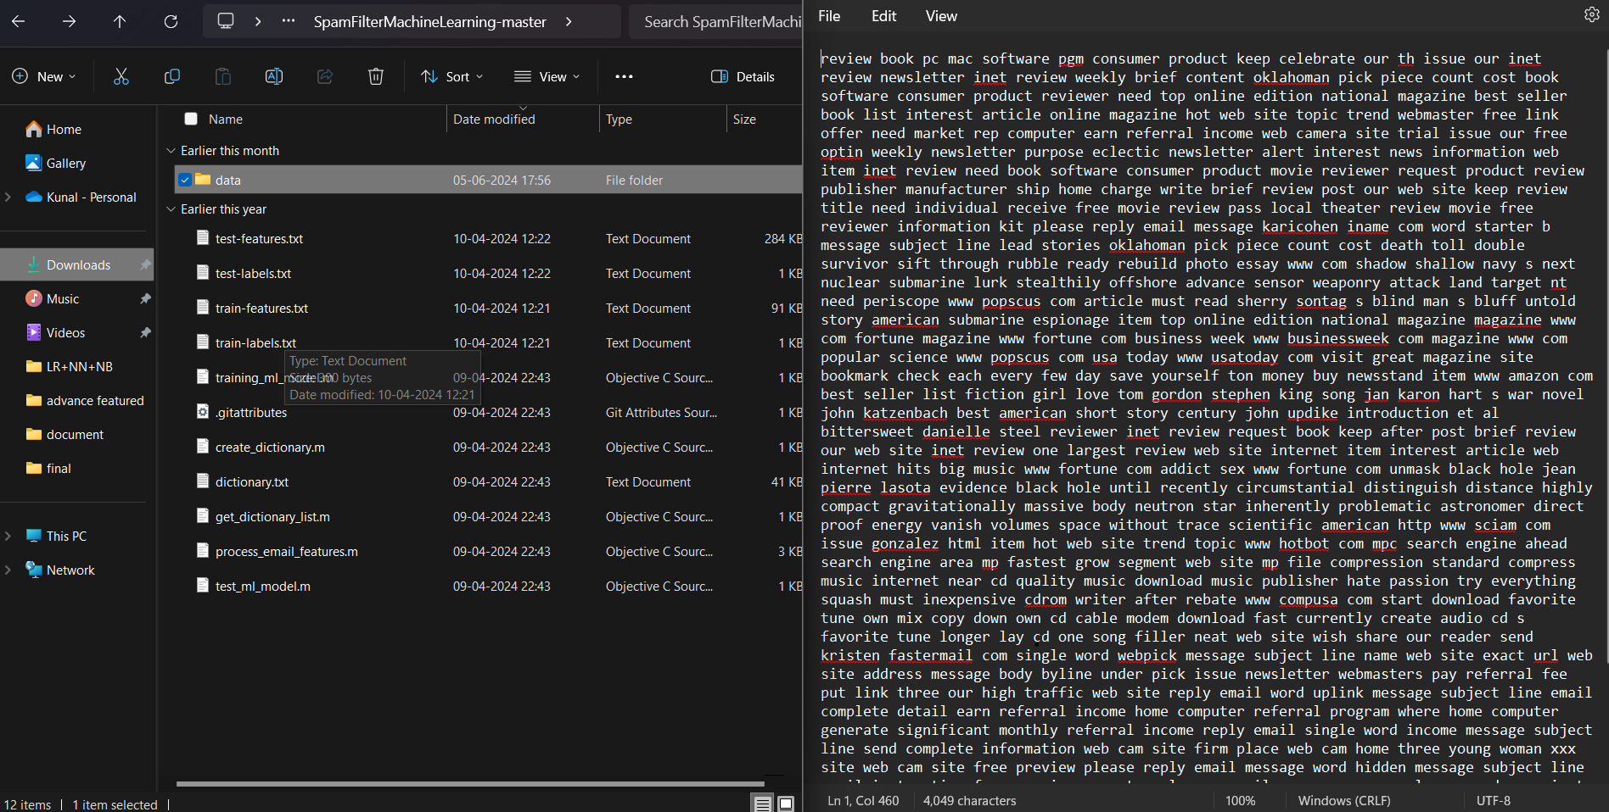
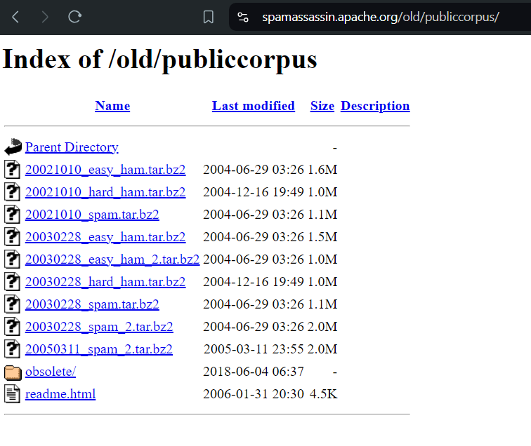
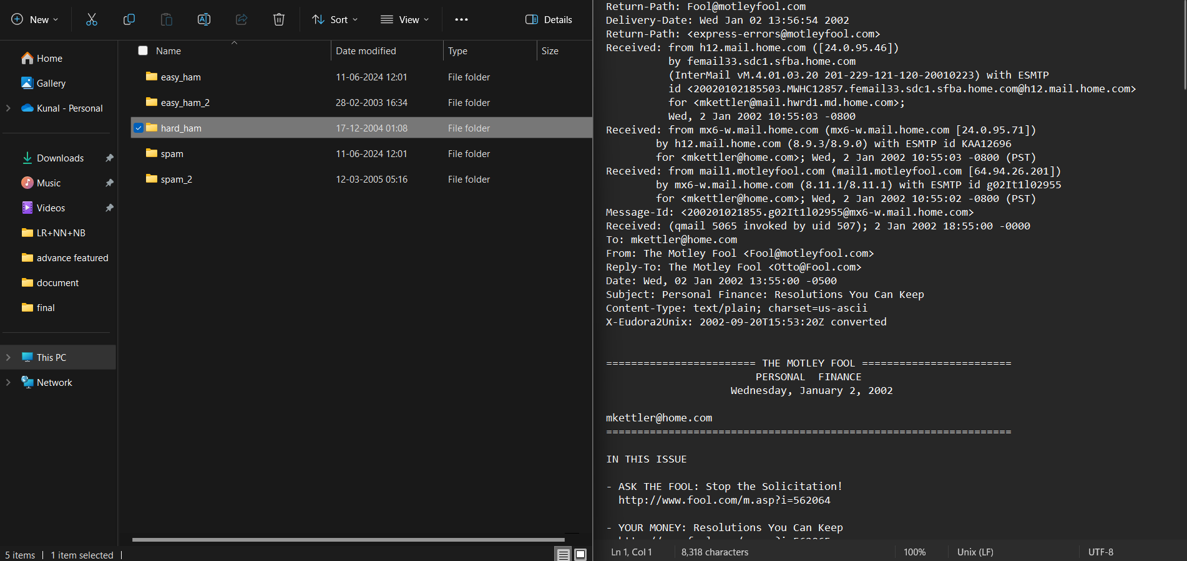
Data Processing and Model Training
Data collection

Slide 5
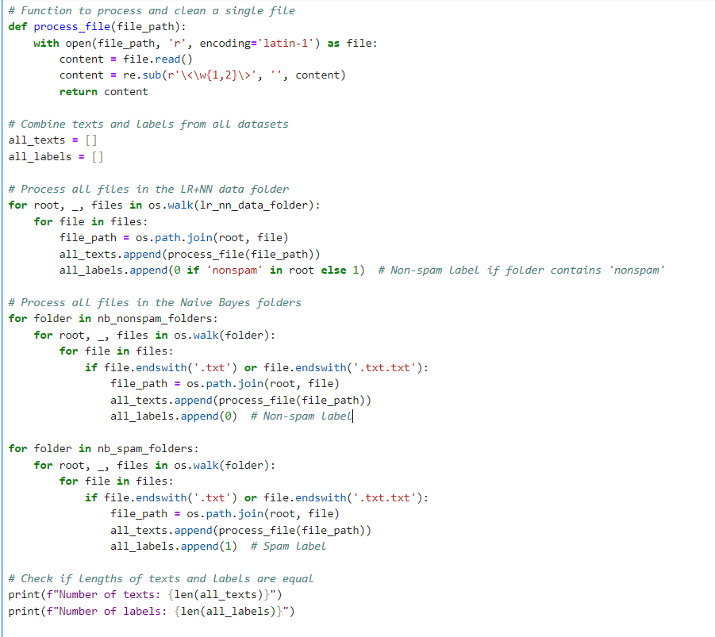
Data Processing and Cleaning
Code Section:
Function used for processing cleaning email files
Code that iterates
through the folders to process the files.

Slide 6
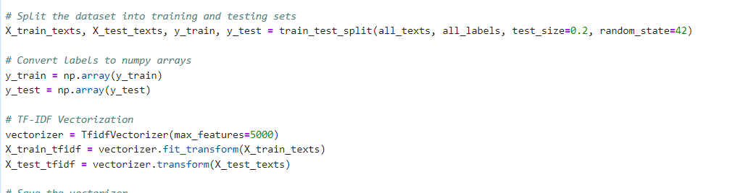

Code Section: Dataset split into training and testing sets, and TF-IDF vectorization applied.

Slide 7
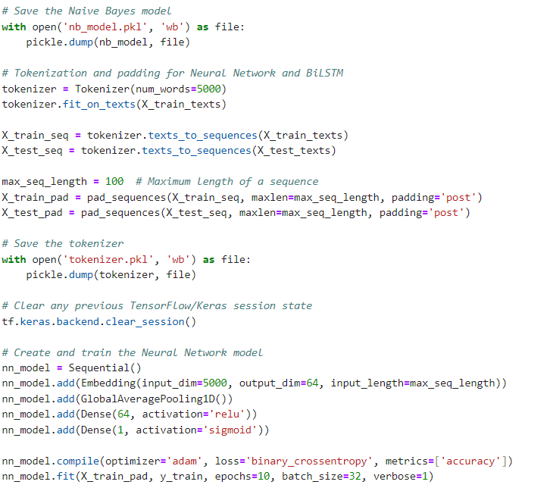
Naive Bayes Model Training: Neural Network Model Training:

Slide 8
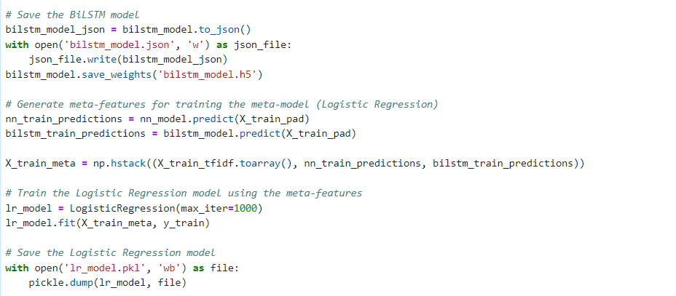
BiLSTM Model Training Logistic Regression Meta-Model Training

Slide 9
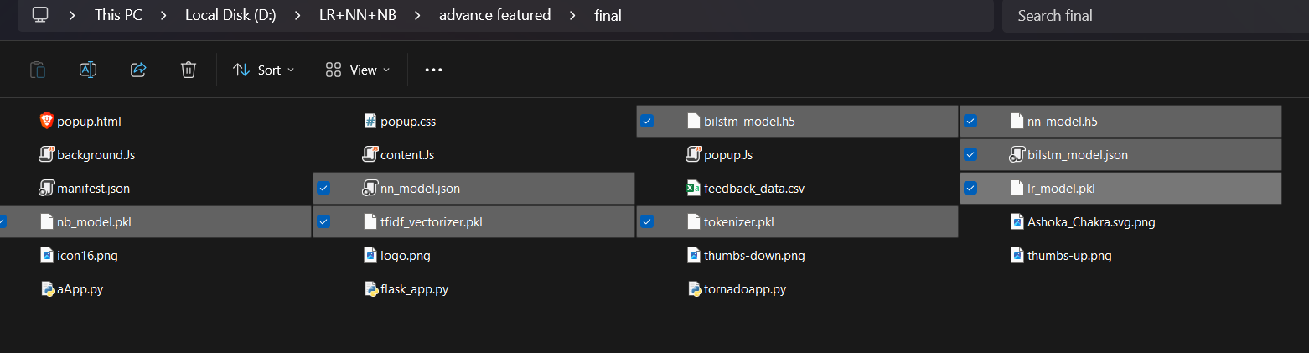
Models Trained
Models were successfully trained and saved in the respective directory.

Slide 10
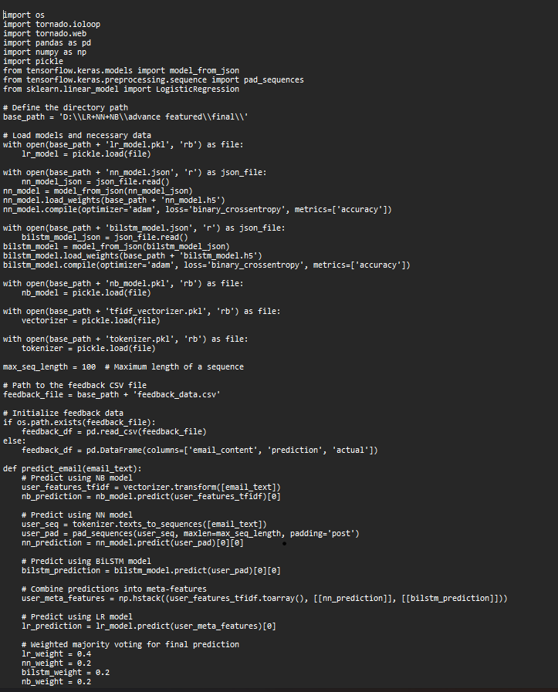
Transition to Chrome Extension
Objective: Provide a seamless user experience within Gmail.
Benefits: Automated content fetching, local processing, enhanced user interaction.
server's role in handling spam detection.

Slide 11
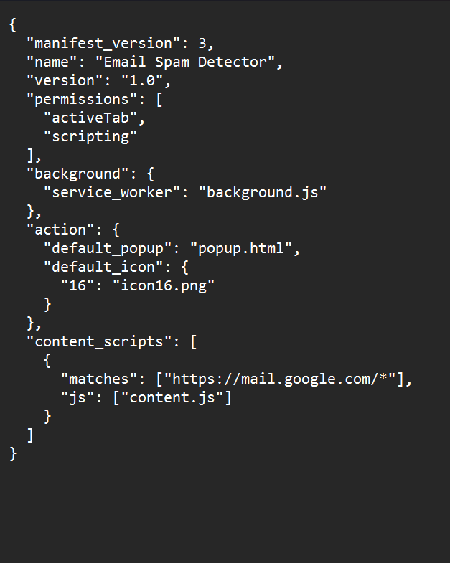
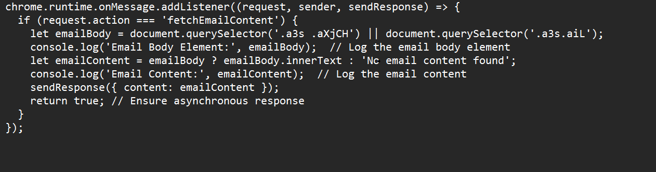
Chrome Extension - Manifest and Content Script

Slide 12
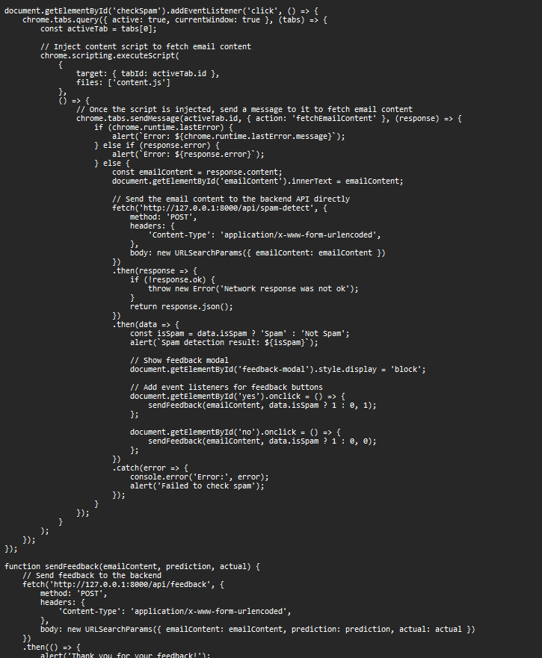
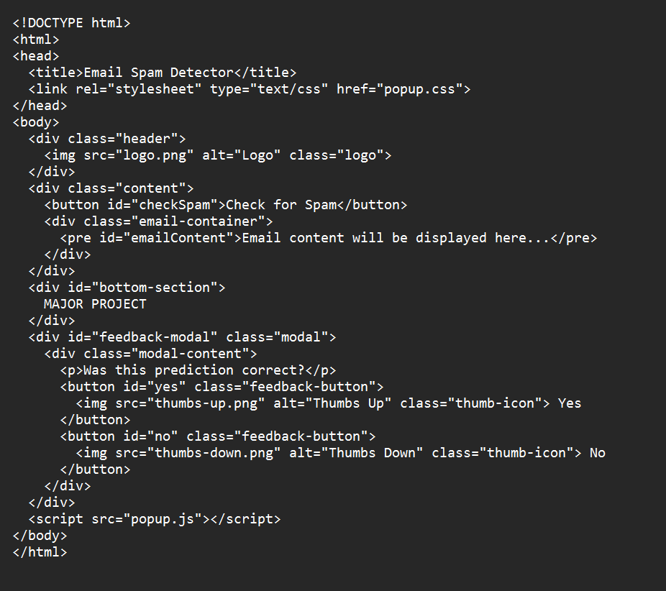
Popup Script and HTML

Slide 13
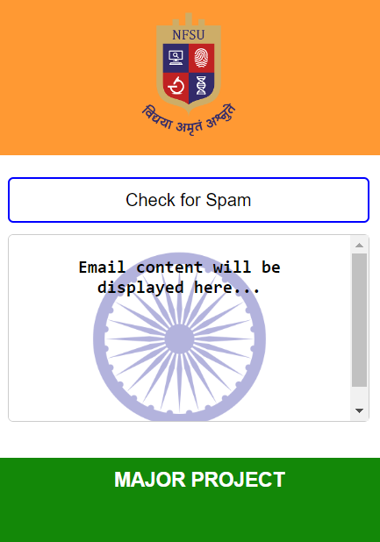
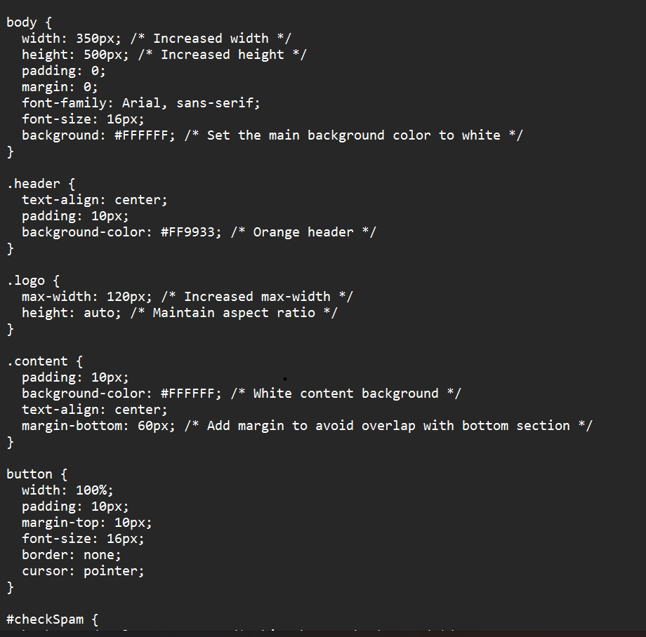
Chrome Extension - CSS and UI

Slide 14
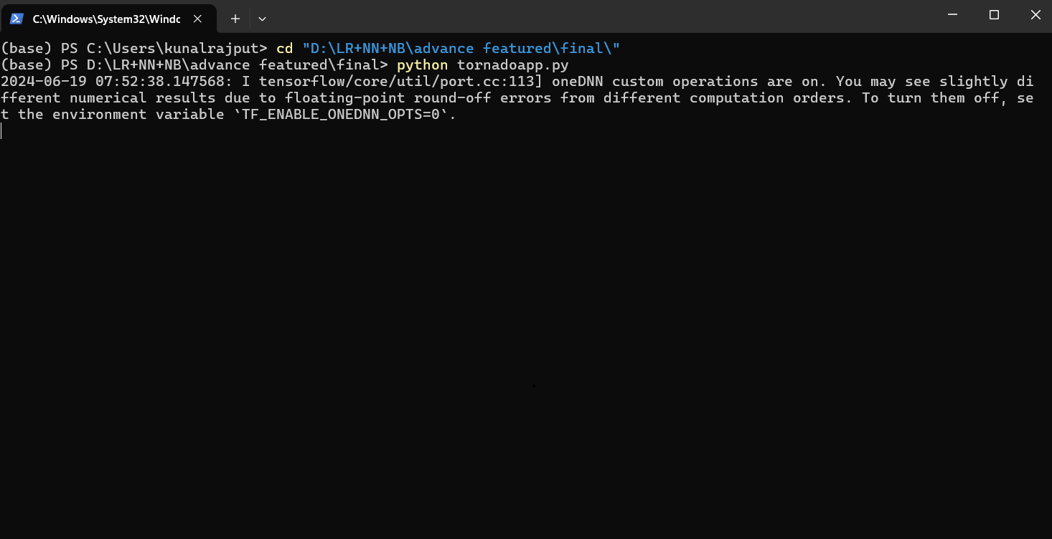
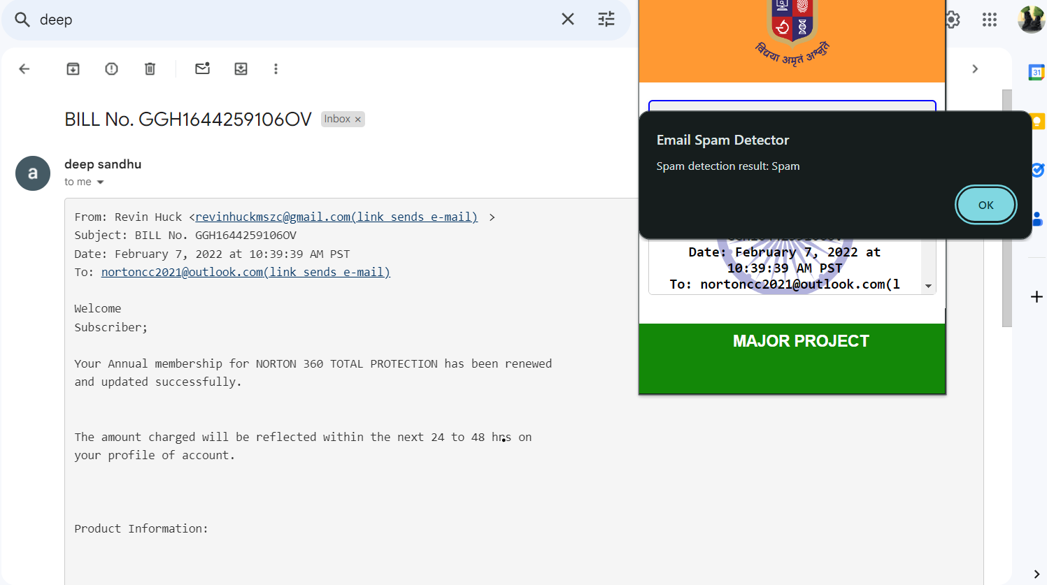
Extension

Slide 15
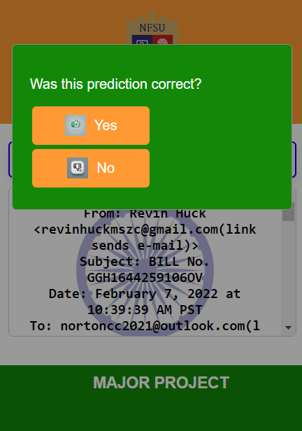
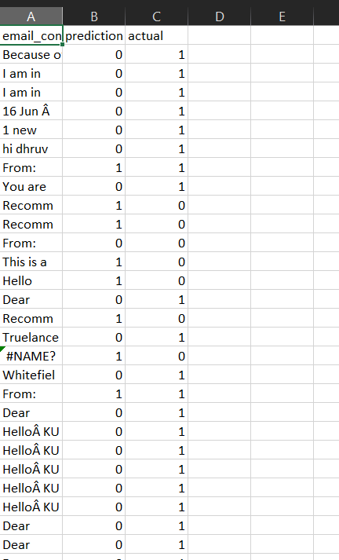
Extension

Slide 16
Future Works and Enhancements
Completed enhancements: Feedback mechanism, GUI improvements, automated retraining.
Future enhancements: Reward and punishment system, URL checker integration, additional email features.

Slide 17
Thank You:

